Slide 1
Class 2 – 11 Sept
Conditionals
Basic input
Variables

Slide 2
Previously, in IMM120
Where is Professor Hallberg’s office?
Adjunct office: 3rd floor, right at the end of the hall.
When are Professor Hallberg’s office hours?
All day Monday from 10am until class.
What three Canvas features do you find most useful?
“First year here… so I haven’t used it much.”
“I enjoy that there’s an app”

Slide 3
Previously, in IMM120
Attendance (15%) | Less weight: 22% | Fine: 78% | More weight: 0% | 13%
Homework (25%) | Less weight: 5% | Fine: 90% | More weight: 5% | 26%
Midterm Project (25%) | Less weight: 5% | Fine: 90% | More weight: 5% | 26%
Final Project (35%) | Less weight: 5% | Fine: 90% | More weight: 5% | 35%

Slide 4
Anything else?
Questions, concerns, homework questions?

Slide 5
Debugging Tips
BUGS!! AAA!!!

Slide 6
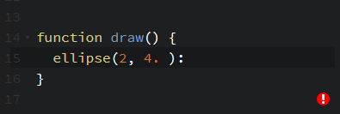
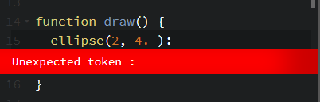
Codepen’s Helper

Slide 7
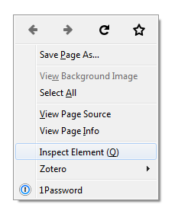
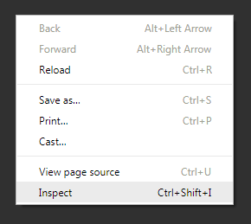
Browser Console

Slide 8
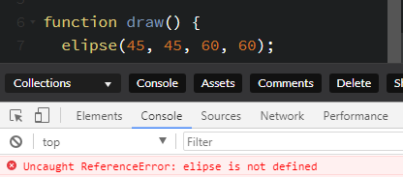

Browser Console

Slide 9
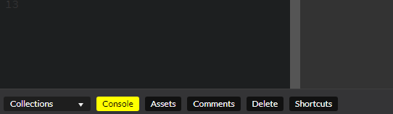
Report Data
print(something);
console.log(something);
Make sure you use it inside of a function to avoid printing, like, onto paper.

Slide 10
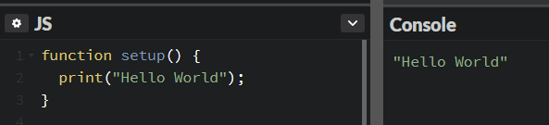
Report Data

Slide 11
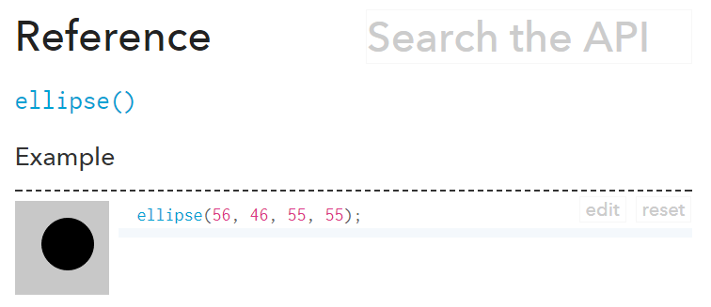
p5.js Reference
https://p5js.org/reference

Slide 12
Is That A Bomb????

Slide 13
4. Conditionals

Slide 14
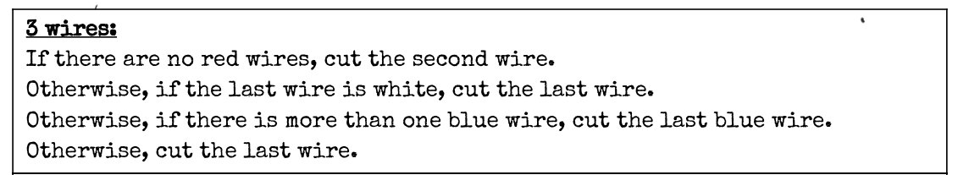
Conditionals In English

Slide 15
Conditionals In English
"If you see a bear, run!"
"If you're going to be late, give me a call."

Slide 16
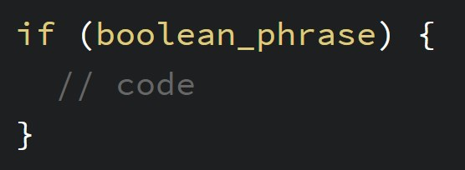
Conditionals in Code

Slide 17
Conditionals In English
"If there's an orange soda, I'll take that. If not, I'll have a cola."
"If you can't make it, that's fine."

Slide 18
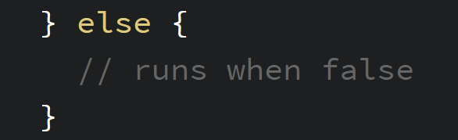
Conditionals in Code

Slide 19
Boolean Operators
< | Less than | True: 4 < 5 False: 100 < 0
> | Greater than | True: 15 > 7 False: -1 > 1
== | Equal to | True: 4 == 4 False: 4 == 3
!= | Not equal to | True: 3.14 != 3 False: 1 != 1
!() | Not operator | True: !(False) False: !(True)

Slide 20
5. Basic Input
Input events

Slide 21
Numbers that Change
Using a label instead of a number
A label that represents the same value, but that value can change at any time
We call these variables

Slide 22
p5.js Numbers That Change
Think of fill and stroke variables
width and height
mouseX will always be the horizontal position of the cursor
Number of pixels between the cursor and the left edge
mouseY is the vertical position of the cursor
Number of pixels between the cursor and the top edge

Slide 23
Number Mapping
map(number, minActual, maxActual, minOut, maxOut);

Slide 24
Random Numbers
random() > random decimal between 0 and 1 (good for percents)
random(max) > random number between 0 and max
random(min, max) > random number between min and max

Slide 25
5.2 Input Events

Slide 26
How Does p5.js provide event information?
Boolean Variables
Event Functions
mouseIsPressed
keyIsPressed
function mousePressed() { }
function keyPressed() { }

Slide 27
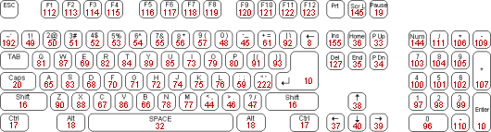
Key Codes

Slide 28
6. Variables

Slide 29
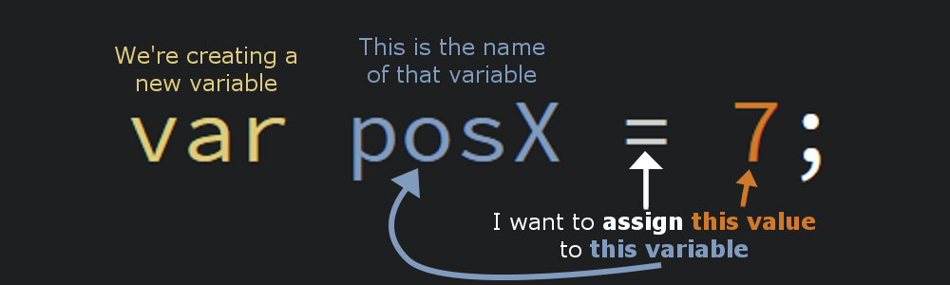
Making Your Own Variables

Slide 30
Saving a Circle

Slide 31
Making Things Move

Slide 32
Mouse Input
Stopping the loop, getting going.

Slide 33
Yep

Slide 34
Homework
Make an eclipse-inspired experience
https://codepen.io/crhallberg/pen/JrPrRz
Inspiration
Vox’s eclipse video: https://www.youtube.com/watch?v=9vFRZ_NFJpY

Slide 35
Minute Survey!
I forgot something, so… flip your survey over…

